Slide 1


welcome To24*7 shop
ONLINE SHOPPING

Slide 2
PROJECT MENTOR NAME: Dr. Amit Gupta
TEAM MEMBER NAME
MAYANK SINGH(2000290140069)
ABHISHEK TIWARI (2000290140007)

Slide 3
I would like to thank my major professor, Dr. Amit Gupta, for his constant guidance and help throughout the project
Shopping has long been considered a recreational activity by many. Shopping online is no exception. The goal of this application is to develop a web based interface for online retailers. The system would be easy to use and hence make the shopping experience pleasant for the users. The goal of this application is
To develop an easy-to-use web-based interface where users can search for products, view a complete description of the products and order the products.
A search engine that provides an easy and convenient way to search for products specific to their needs. The search engine would list a set of products based on the search term and the user can further filter the list based on various parameters.

Slide 4
The current system can be extended to allow the users to create accounts and save products in to wish list.
The users could subscribe for price alerts which would enable them to receive messages when price for products fall below a particular level.
The current system is confined only to the shopping cart process. It can be extended to have a easy to use check out process.
Users can have multiple shipping and billing information saved. During checkout they can use the drag and drop feature to select shipping and billing information.

Slide 5
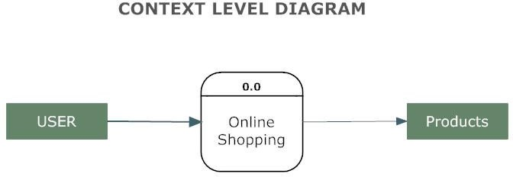
Working of the projecT

Slide 6
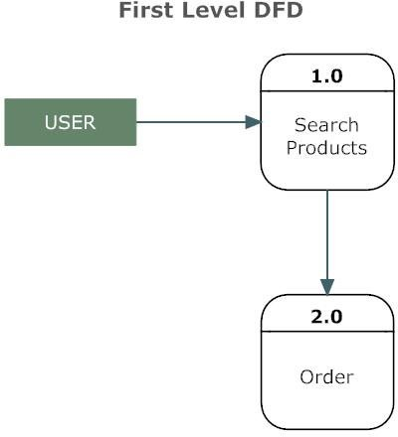
Simple view

Slide 7
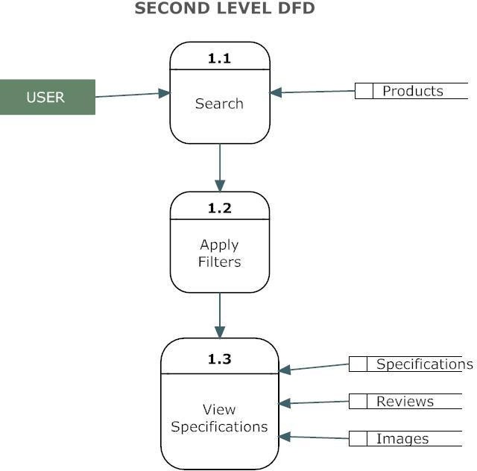
User OPRATION

Slide 8
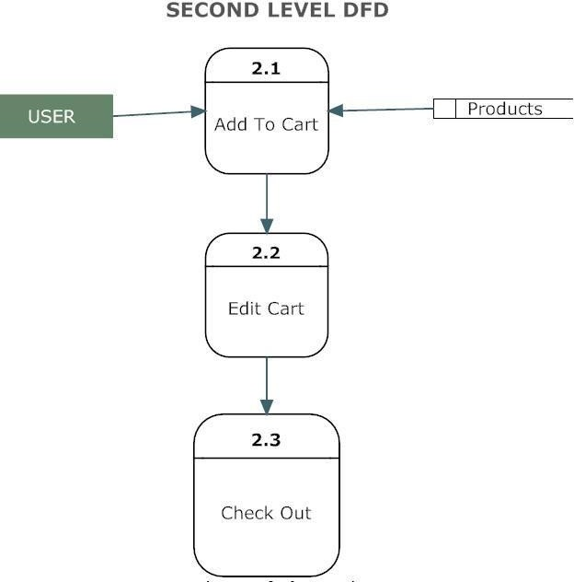
ADD TO CART PROCESS

Slide 9
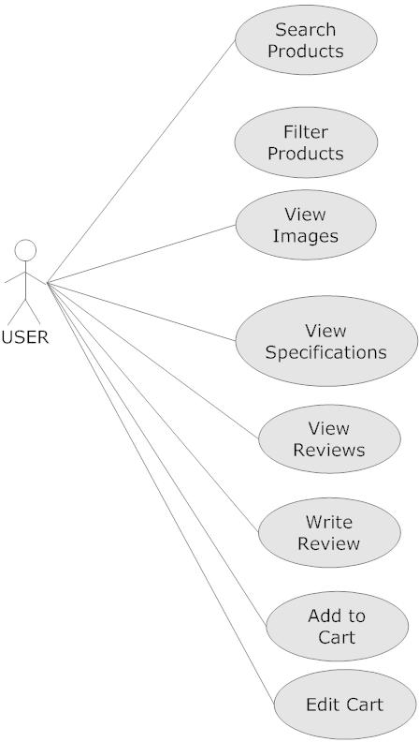

Slide 10
Technology USED IN PROJECT
DESIGNING
REACT JS
Bootstrap
FOR DATABASE
Firebase
PAYMENT
Stripe: Online payment processing for internet businesses

